Slide 1
Models of the motor system
Fall 2021
Opher Donchin

Slide 2
Part 1
Limitations of the error based model

Slide 3
Types of eye movements
Fixation
Vestibulo-ocular reflex
Optokinetic reflex
Micro-saccades
Tracking
Smooth pursuit
Gaze shift
Saccades

Slide 4
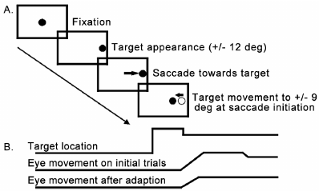
Saccade adaptation
Saccade blindness
Target jump during saccade
Mosconi Plos One 2013 doi:10.1371/journal.pone.0063709

Slide 5
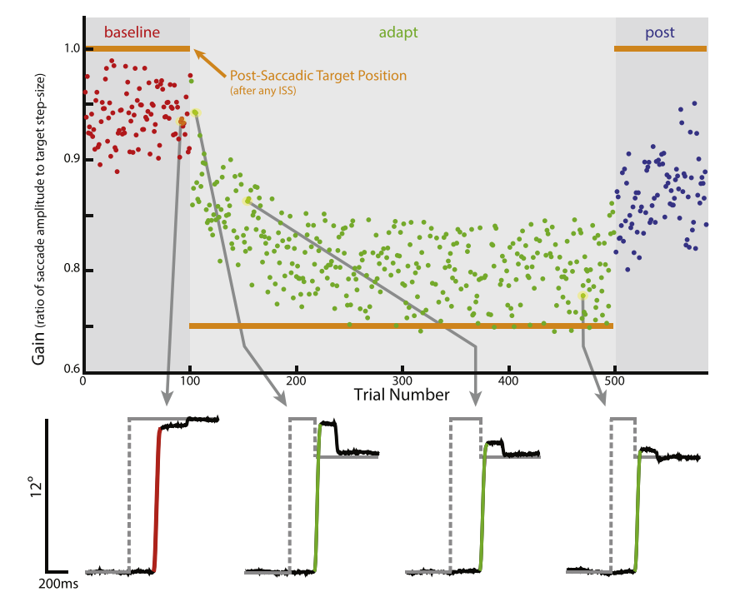
Saccade adaptation
Saccade blindness
Target jump during saccade
Adaptation
Herman Exp Eye Res 2013 doi:10.1016/j.exer.2013.04.001

Slide 6
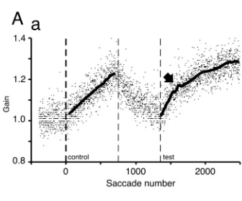
Savings in saccade adaptation
More rapid re-learning
Widespread learning phenomenon
Kojima J Neurosci 2004 doi:10.1523/JNEUROSCI.1741-04.2004

Slide 7
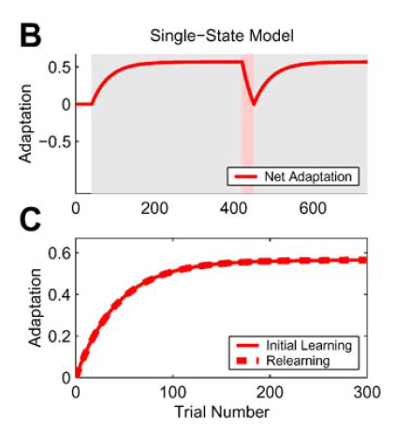
Savings can’t be explained by one state model
Once the state is gone, it’s gone
Smith PLOS Biol 2006 doi:10.1371/journal.pbio.0040179

Slide 8
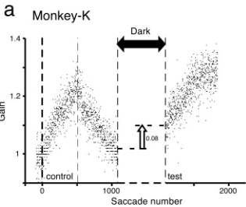
Spontaneous recovery
Unlearning doesn’t wipe out learning
Kojima J Neurosci 2004 doi:10.1523/JNEUROSCI.1741-04.2004

Slide 9
Part 2
The two-state model

Slide 10
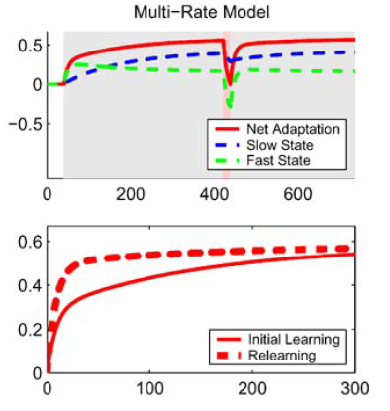
The two-state model
Two time constants
Fast: fast learning + fast forgetting
Slow: slow learning + slow rogetting
Smith PLOS Biol 2006 doi:10.1371/journal.pbio.0040179

Slide 11
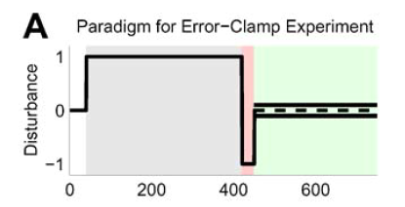
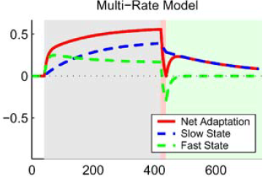
Two state model explains spontaneous recovery
Error
Smith PLOS Biol 2006 doi:10.1371/journal.pbio.0040179

Slide 12
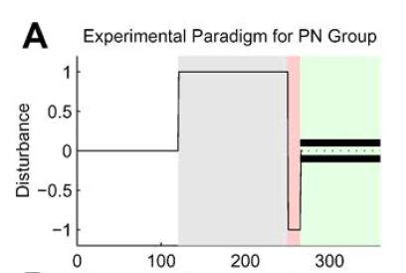
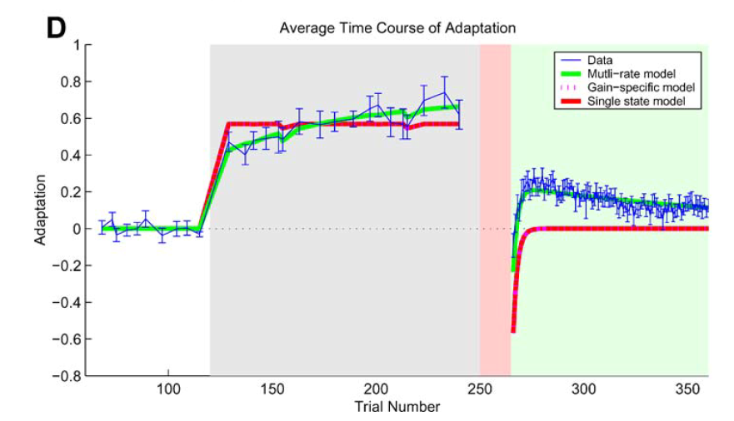
Experimental verification
Smith PLOS Biol 2006 doi:10.1371/journal.pbio.0040179

Slide 13
Part 3
Explicit and implicit adaptation

Slide 14
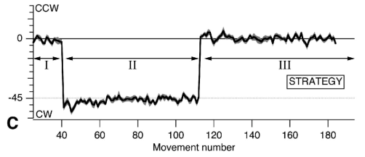
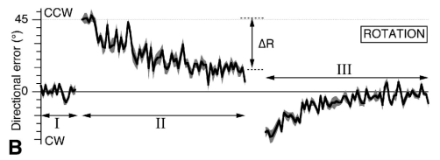
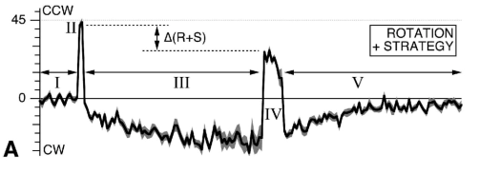
Interaction of adaptation and strategy
Strategy alone
People can move where we ask them
Adaptation alone
People can adapt
Interaction
Adaptation precedes despite strategy
Mazzoni J Neurosci 2006 doi:10.1523/JNEUROSCI.5317-05.2006

Slide 15
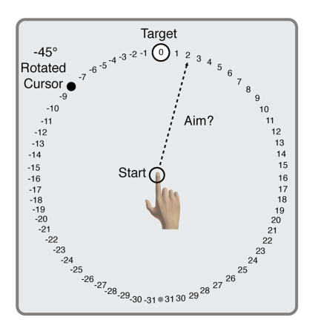
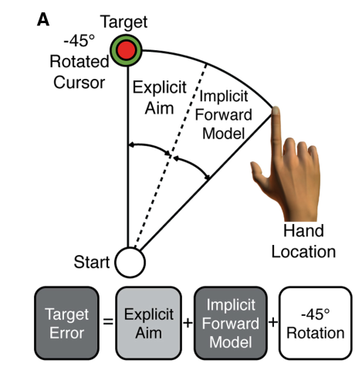
Measuring explicit intention
Just ask
Where are you aiming?
The rest is implicit
Taylor J Neurosci 2014 doi:10.1523/JNEUROSCI.3619-13.2014

Slide 16
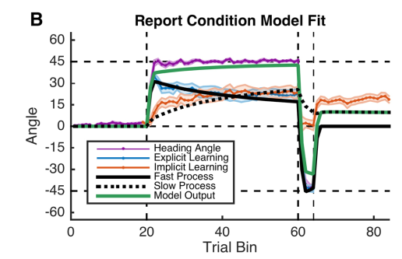
Explicit and implicit match fast and slow
McDougle J Neurosci 2015 doi:10.1523/JNEUROSCI.5061-14.2015

Slide 17
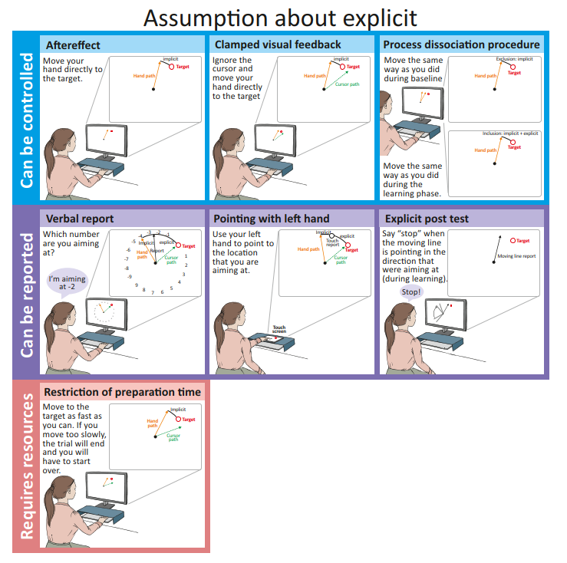
Many ways to measure intention

Slide 18
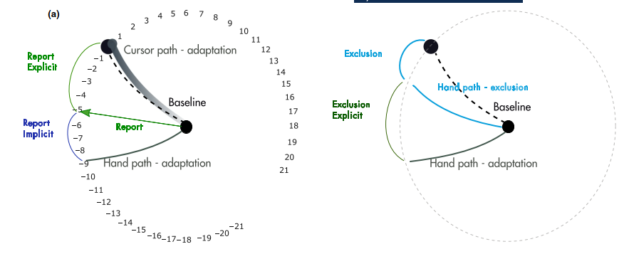
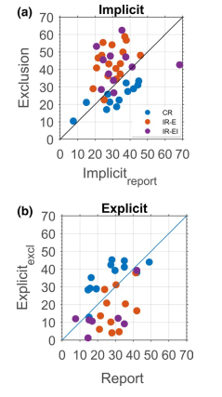
The measure matters
Consistent reporting
Report shows more explicit
Intermittent reporting
Exclusion show more explicit
CR: consistent reporting
IR: Intermittent reporting
Maresch EJN 2020 doi:10.1111/ejn.14945

Slide 19
Part 4
Sub-components

Slide 20
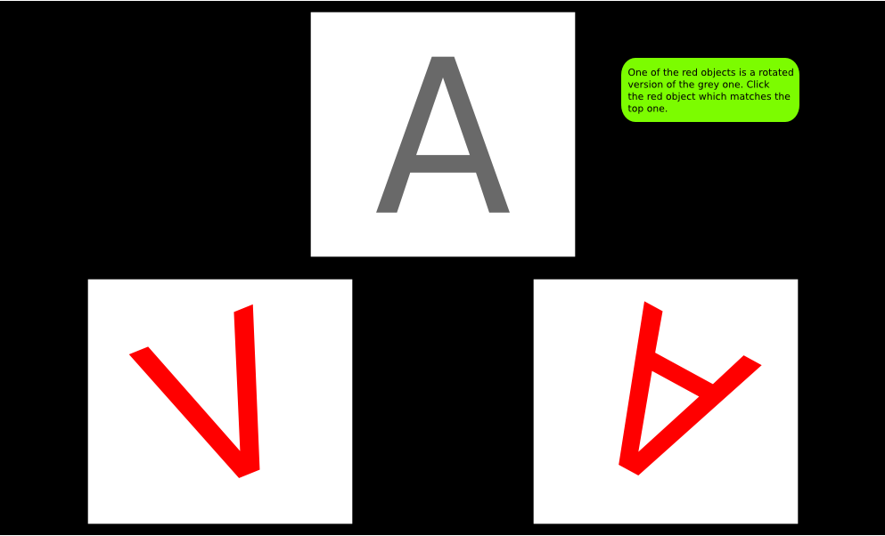
Mental rotation tasks
Try it
https://www.psytoolkit.org/lessons/experiment_mentalrotation.html

Slide 21
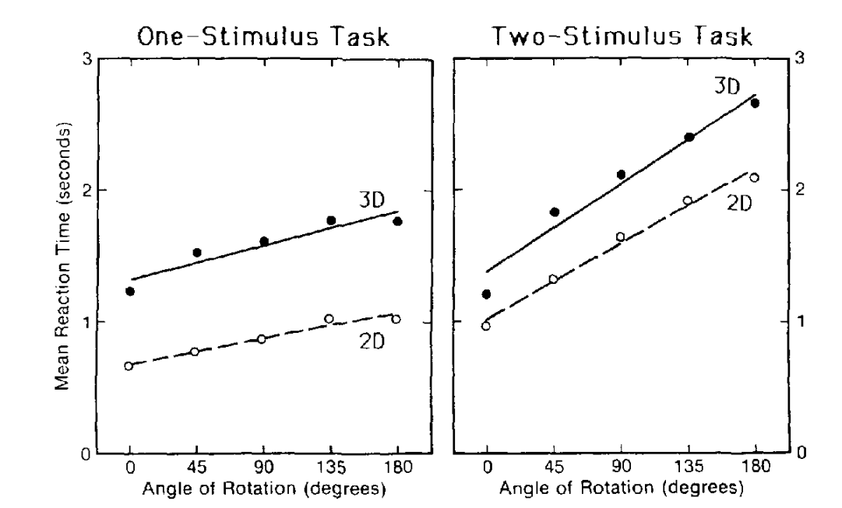
Reaction time scales with rotation distance
We know you are performing mental rotation because it takes you time to rotate
Shepard J Exp Psych 1988 doi:10.1037//0096-1523.14.1.3

Slide 22
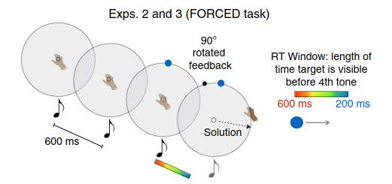
Mental rotation in adaptation
Use tones to force a reaction time
How will adaptation be affected by reaction time?

Slide 23
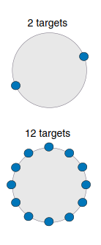
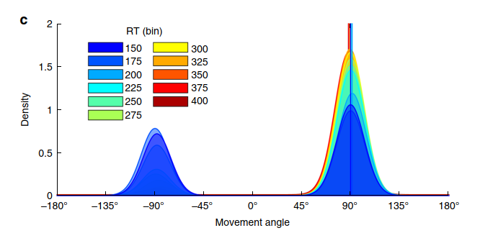
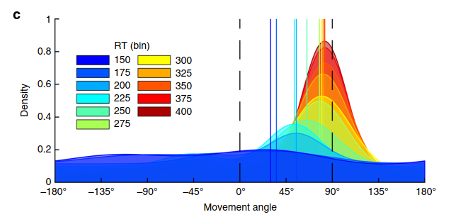
Mental rotation strategy
Multiple targets forces a rotation strategy

Slide 24
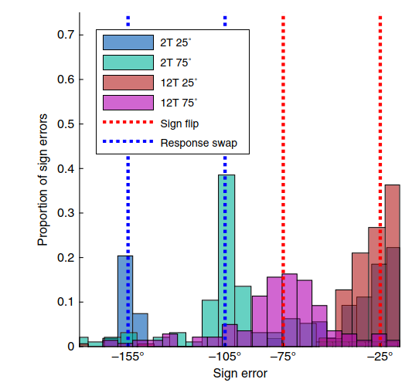
Caching strategy
With 2 targets
Mistakes of going to the wrong target
With 12 targets
Rotating the wrong way

Slide 25
The cerebellum and the two state model

Slide 26
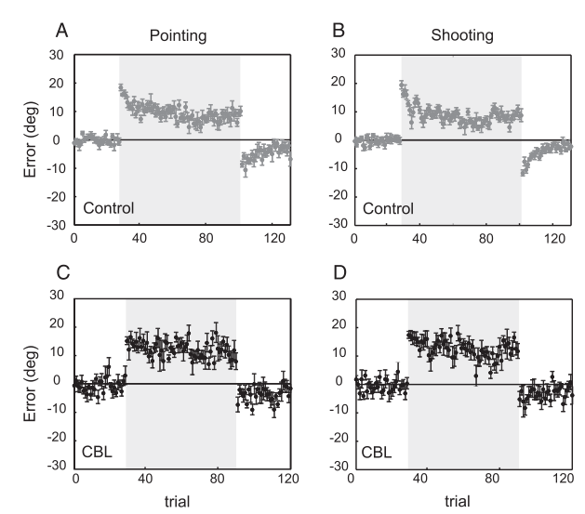
Cerebellum associated with error dependent learning
Tseng J Neurophysiol 2007 doi:10.1152/jn.00266.2007

Slide 27
Control subjects show implicit adaptation despite explicit
Mazzoni J Neurosci 2006 doi:10.1523/JNEUROSCI.5317-05.2006

Slide 28
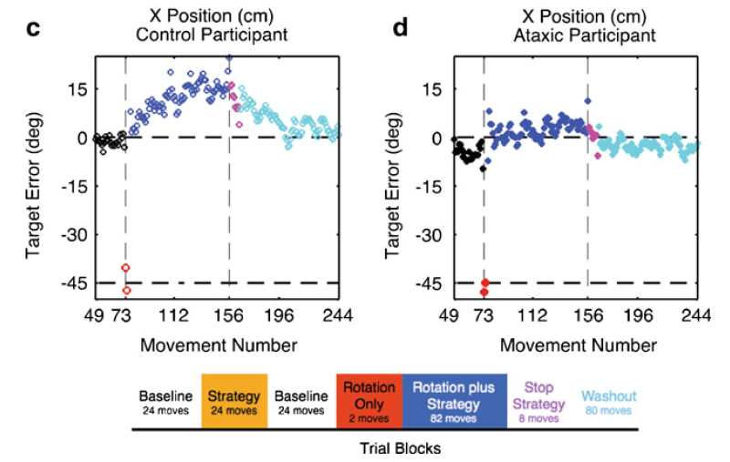
Cerebellar subjects don’t have the implicit learning
Taylor Cerebellum 2010 doi:10.1007/s12311-010-0201-x

Slide 29
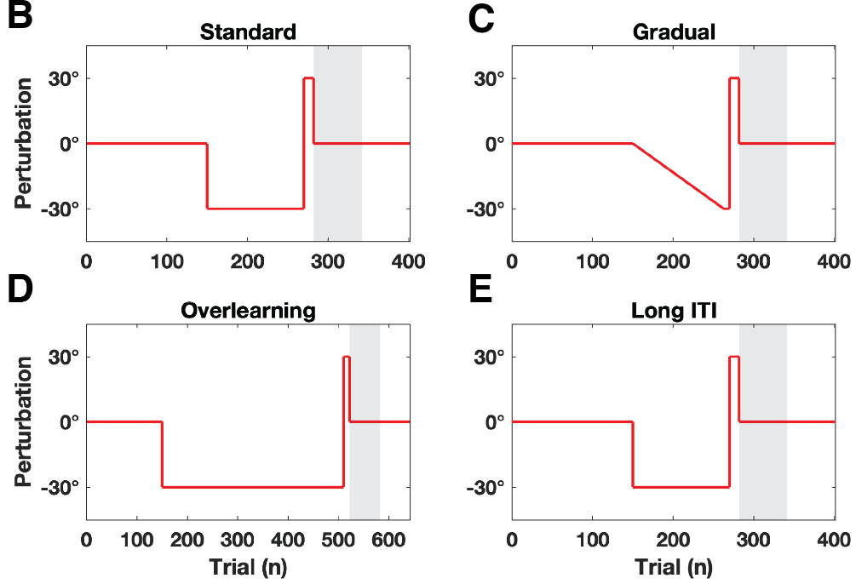
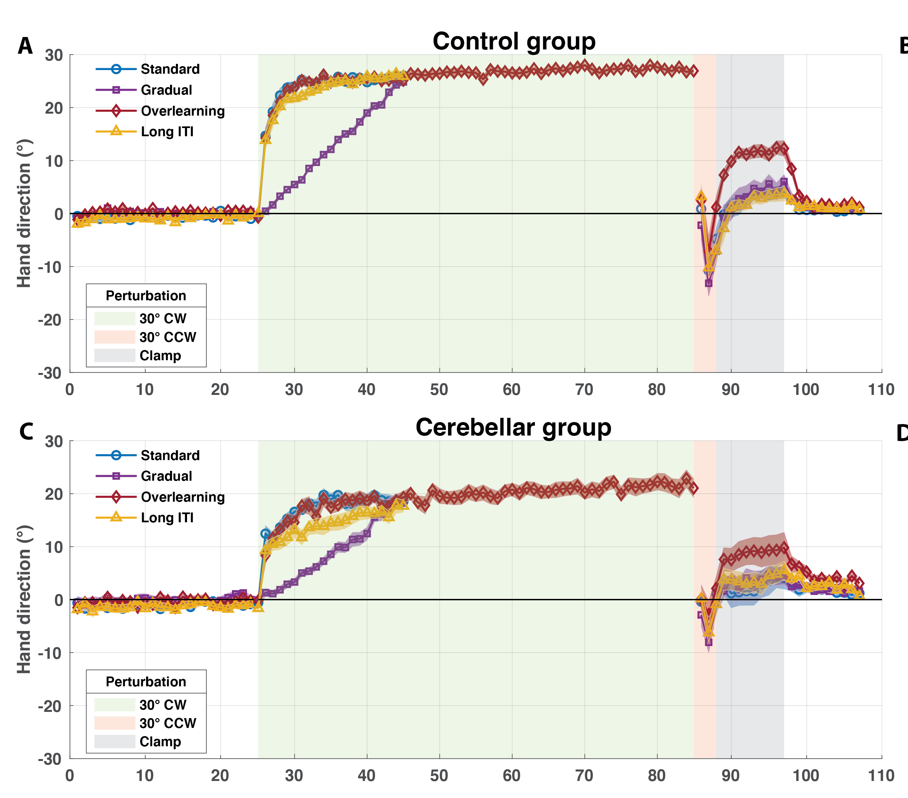
Spontaneous recovery enhanced by overlearning
Hulst bioRxiv doi:10.1101/2020.07.03.185959v2

Slide 30
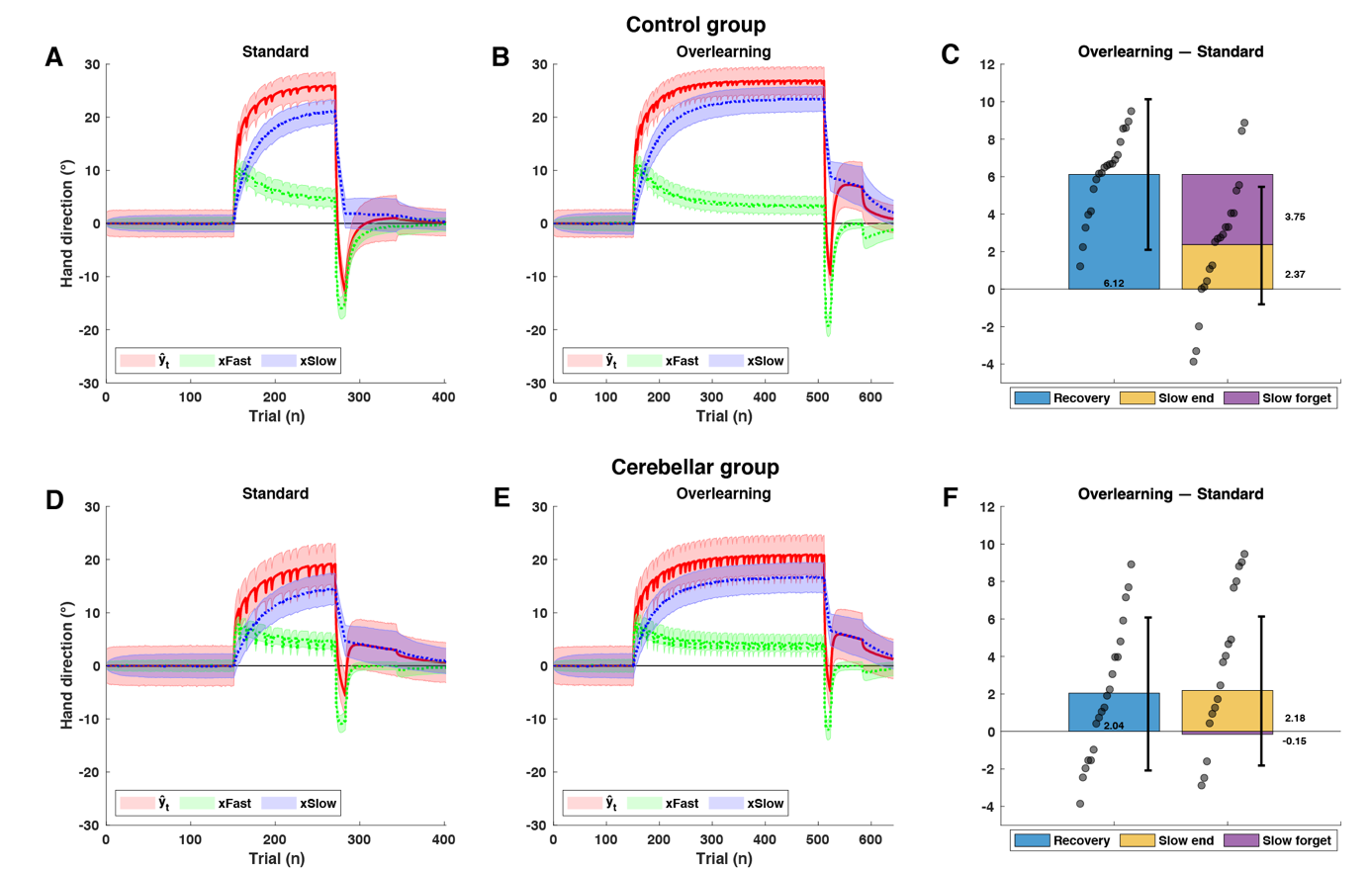
Two state model fits
Hulst bioRxiv doi:10.1101/2020.07.03.185959v2

Slide 31
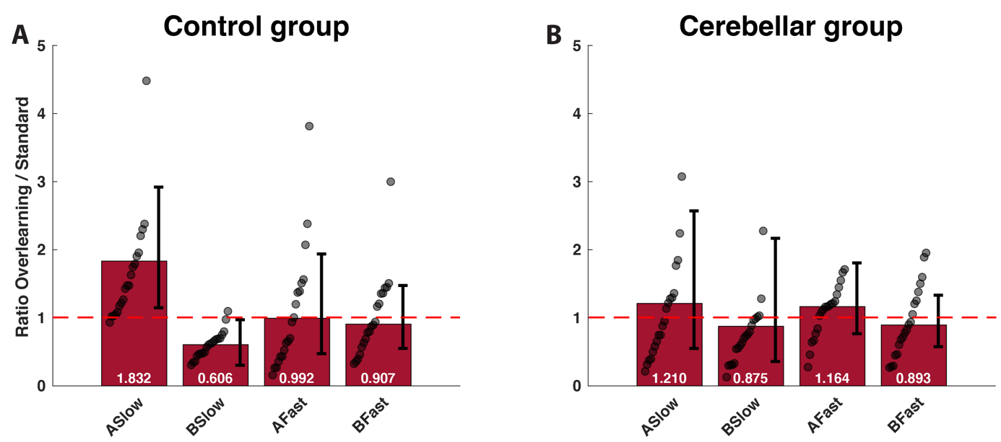
Parameters change in control group
Hulst bioRxiv doi:10.1101/2020.07.03.185959v2

Slide 32
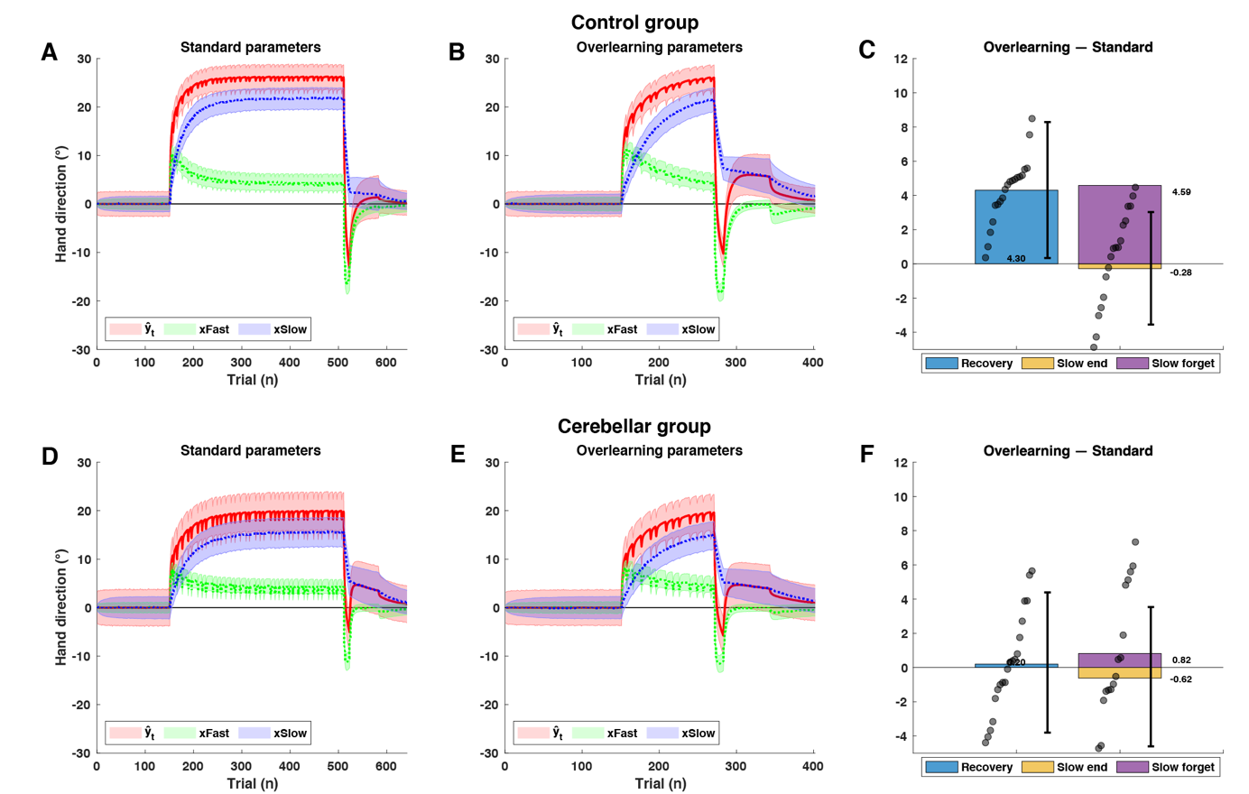
Seeing the effect of the parameter change by switching them
Hulst bioRxiv doi:10.1101/2020.07.03.185959v2

Slide 33
The COIN model

Slide 34
Associative learning model

Slide 35
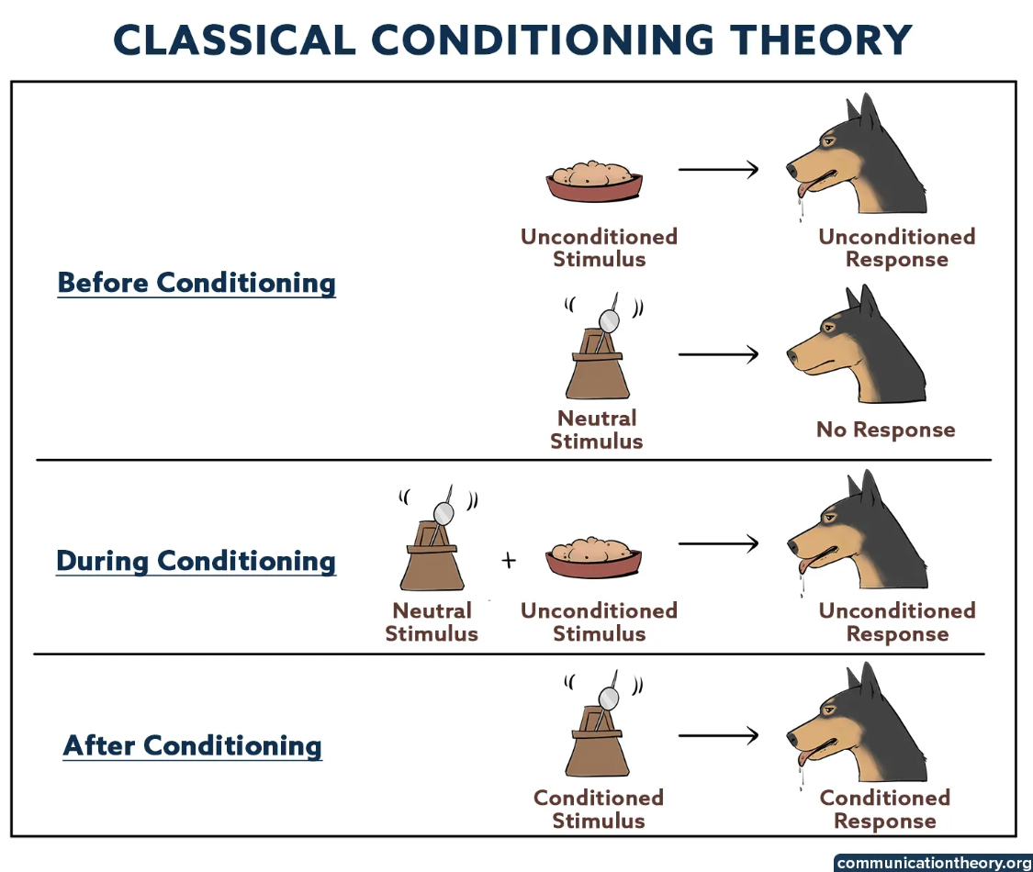
Associative learning
How do we associate cues with appropriate responses

Slide 36
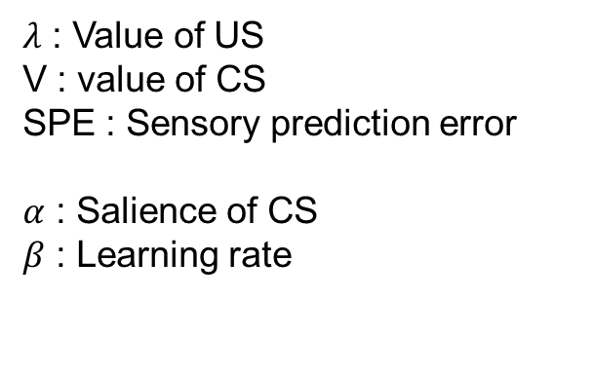
Rescorla-Wagner model
How do we associate cues with appropriate responses
$λ$ : Value of US
V : value of CS
SPE : Sensory prediction error
$α$ : Salience of CS
$β$ : Learning rate
Avraham eLife 2022

Slide 37
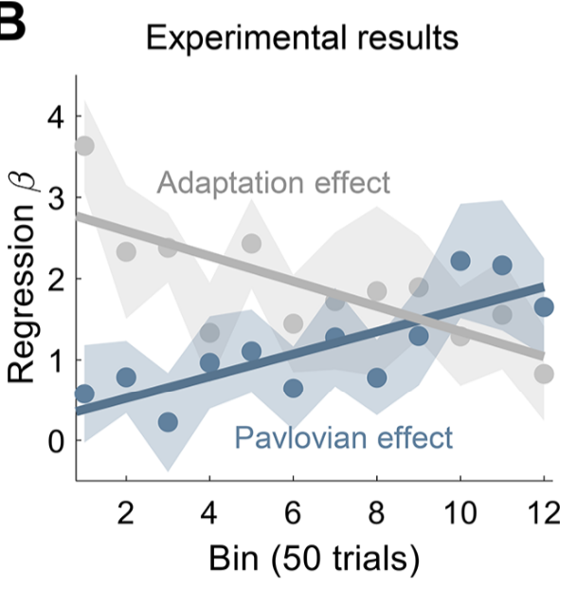
Success of Rescorla Wagner
Adaptation effect: Change in CS+
Pavlovian effect: CS+ - CS-
Avraham eLife 2022

Slide 38
More conditioning experiments
Compound cues
If you receive both a sound and a light
Each receives part of the credit
Prospective Interference
If you learn that a light causes the perturbation
You block later learning of a sound

Slide 39
Contextual inference

Slide 40
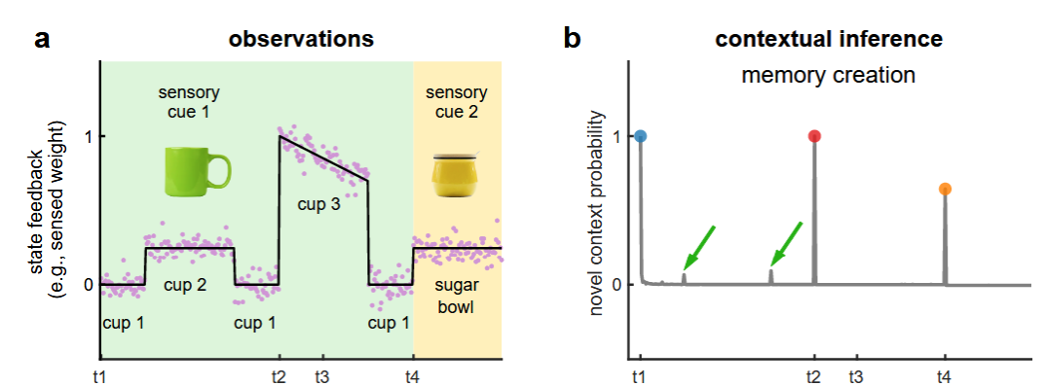
Inferring context is important
New context is inferred if:
The error is large
Cup 3
There is a cue
Sugar bowl
Heald Nature 2021

Slide 41
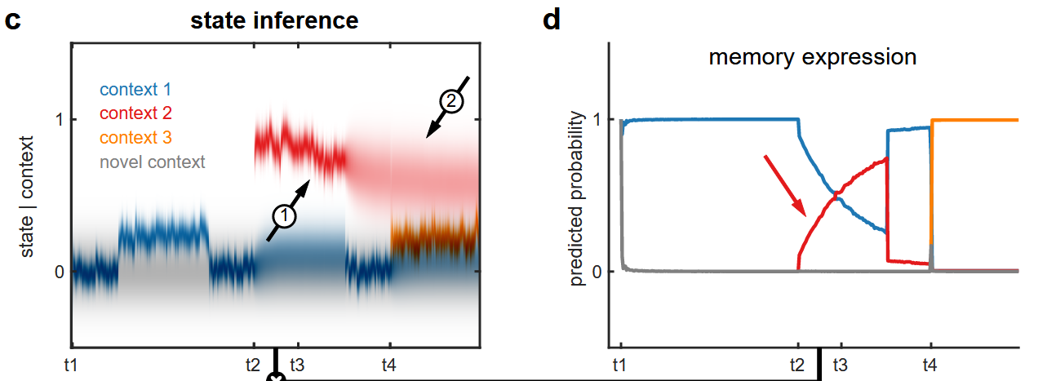
Inferring context is important
Contexts can combine according to probability
Heald Nature 2021

Slide 42

In class project
Use the equations for the single state model
Generate data
Demonstrate no savings
This has no noise
Good place to start
Must choose values for A, B, $σ_{i}$, and $σ_{ε}$
Must choose $\left\{p_{i}\right\}$ and $x_{0}$

Slide 43
If there’s time
Expand equations to two state model
Demonstrate savings

